Slide 1
PSFDH Integrated Quality

Slide 2
Integrated Quality
PSFDH has an Integrated Quality and Safety Framework
Six elements of Quality

Slide 3
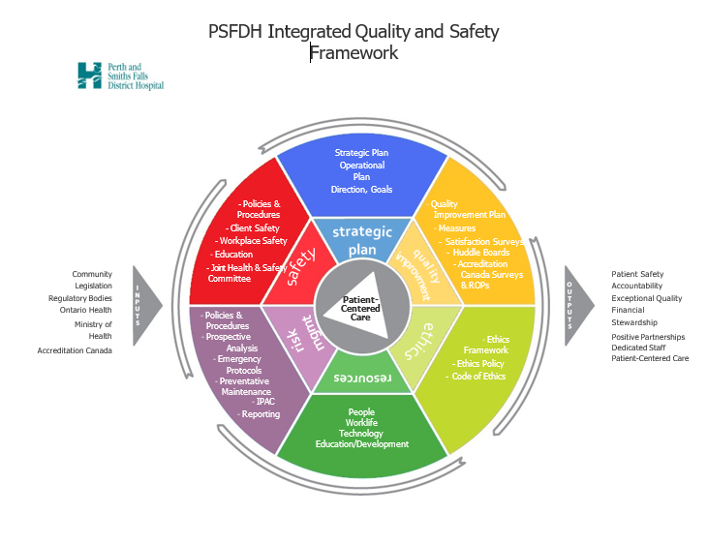
Quality Framework
Safety
Strategic Plan
Quality Improvements
Ethics
Resources
Risk Management

Slide 4
Key Takeaways
Inputs include legislation, regulatory bodies, Ministries, Accreditation Canada
Quality Improvement element includes continuous quality improvement at the departmental level – Huddle Boards, satisfaction surveys
Focus on ethics, our people, along with policy development and workplace health and safety

Slide 5
Key Takeaways
Quality Root Cause Analysis, Morbidity and Mortality reviews
Enterprise Risk Management
Financial stewardship – people, equipment, funding
Strategic and Operational plans centre around Quality
Monitoring is ongoing
Joint Health and Safety is paramount

Slide 6
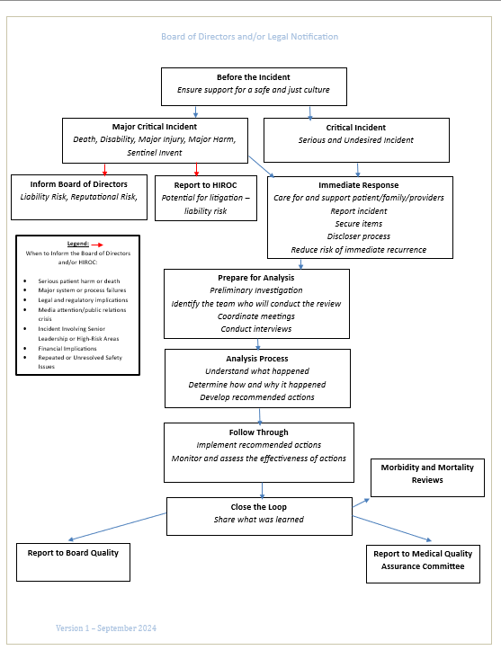
Flow of Incidents and Reporting
Support our staff and physicians by immediately responding
Analyze critical incidents
Inform our Board and report to HIROC
Report reviews and review trends at Medical Quality Assurance Committee
Report to Board Quality
Review morbidity and mortality cases

Slide 7
Questions?
Integrated Quality and Safety Framework included for review

